Slide 1
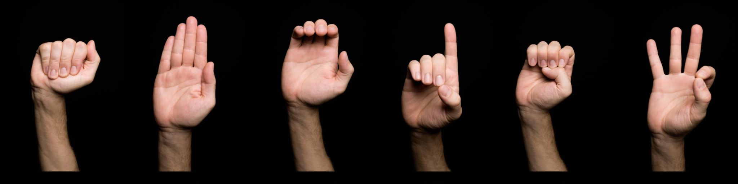
Sign Language Interpretation And Learning Tool​
Bridging The Gap​

Slide 2
Team Members​
​Rahul Musalay​
Baibhav Kumar Pathak​
Parthesh Parikh​

Slide 3
The problem statement
Communication Barrier:
Over 5% of the world's population, or 430 million people, are hearing or speaking impaired. Many rely on sign language as their primary mode of communication, which is not universally understood.
Inclusivity and Accessibility Issues:
The lack of sign language comprehension contributes to inadequate accessibility in educational, workplace, and public environments. This results in significant disadvantages for deaf individuals in social, educational, and professional contexts.
Challenges in Learning Sign Language:
Acquiring proficiency in American Sign Language (ASL) presents a considerable challenge for English speakers, akin to learning Japanese, due to its complexity and distinct structure.

Slide 4
Motivation
The problem of communication barriers faced by the hearing or speaking impaired population is a significant global challenge affecting millions of individuals.
Deaf individuals often encounter obstacles in accessing essential services and opportunities due to limited understanding and use of sign language by the general population.
Lack of accessibility prevents equal opportunities and perpetuates disadvantages for this marginalized community.
By equipping deaf individuals with tools that enhance their ability to communicate, we empower them to lead more independent lives.

Slide 5
Proposed Solution
Develop a automated software based system that can recognize and interpret American Sign Language (ASL) gestures captured through a camera or video feed.
This will eliminate the need for human interpreters and the steep learning curve of ASL.
A user-friendly interface accessible via mobile applications or web platforms, allowing users to interact with the Sign Language Converter system easily.
Convert the recognized sign language gestures into letters in real time. Then form words and sentences by appending the letters.
Provide a way for Non-ASL speakers to learn and signs and communicate back.

Slide 6
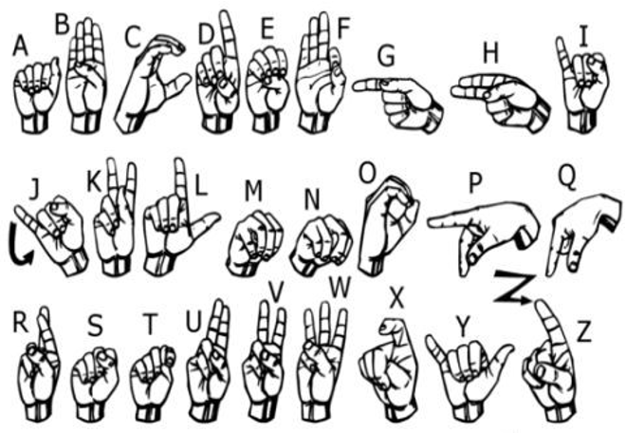
Sign Language Detection Methodology
Live Video Stream Capture:
Utilize a live video stream from a camera to capture ASL signs in real-time.
Image Processing and Prediction:
Process captured images using Computer Vision techniques
Employ Machine Learning algorithms to predict the signed letter accurately.
Feedback and Reference Tools:
Provide reference images for each ASL letter on the user interface.
Display a confidence score for the predicted letter to assist users in verifying and improving their signing accuracy.

Slide 7
Learning ASL Signs with our Tool
Importance of Two-Way Communication in ASL:
Effective communication in American Sign Language (ASL) involves both reading and signing skills.
Incorporation of Reference Images:
Provide reference images of ASL letter signs on the web user interface to assist users in learning correct hand positions.
Accuracy Feedback:
Display the "Accuracy" of the signed letter on the web UI, creating a feedback loop that helps users refine their signing skills.

Slide 8
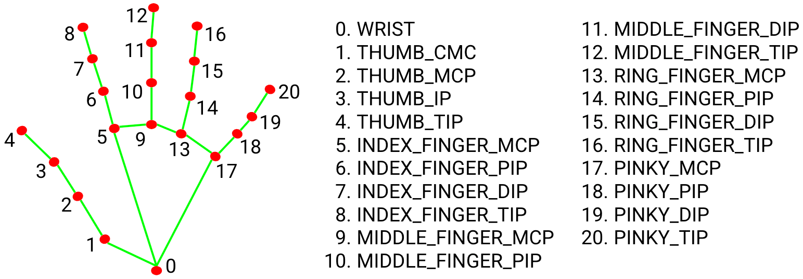
Hand Landmark Detection
Pre-trained Model Usage:
Utilize the pre-trained Google MediaPipe model for initial processing.
Palm Detection:
Employs a Single Shot Detector (SSD) Model specifically designed to detect the palm within the video feed.
Hand Landmark Extraction:
From the cropped palm image, we use the Hand Landmark Model to extract 21 distinct points, mapping the key features of the hand.
Mobile Device Compatibility:
Implement the solution using a TensorFlow Lite (TFLite) model to ensure compatibility and efficient performance on low-compute mobile devices.

Slide 9
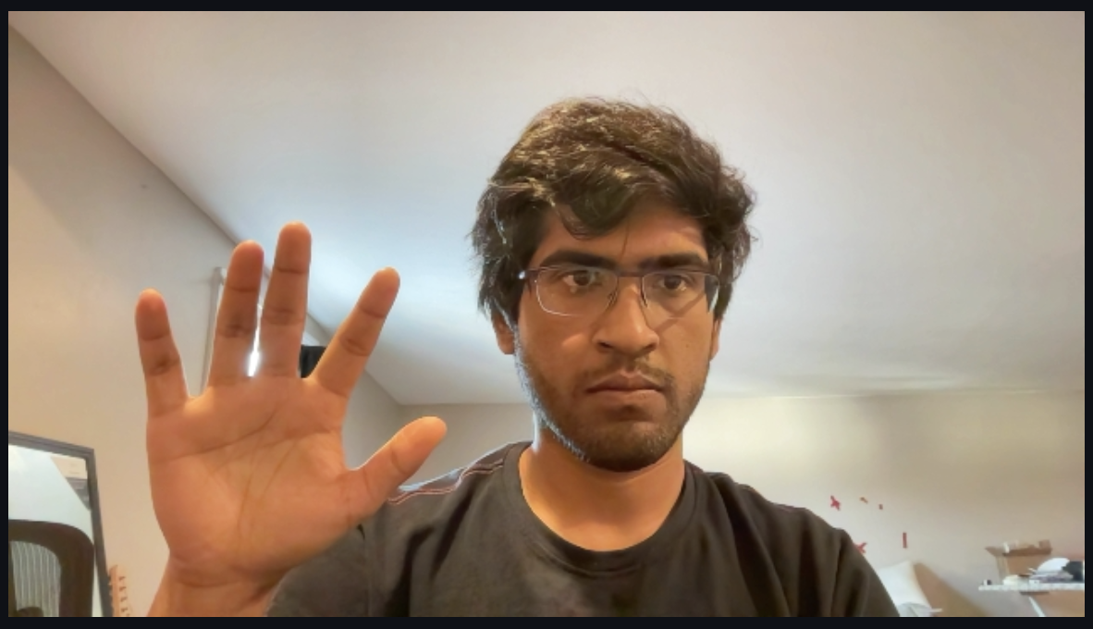
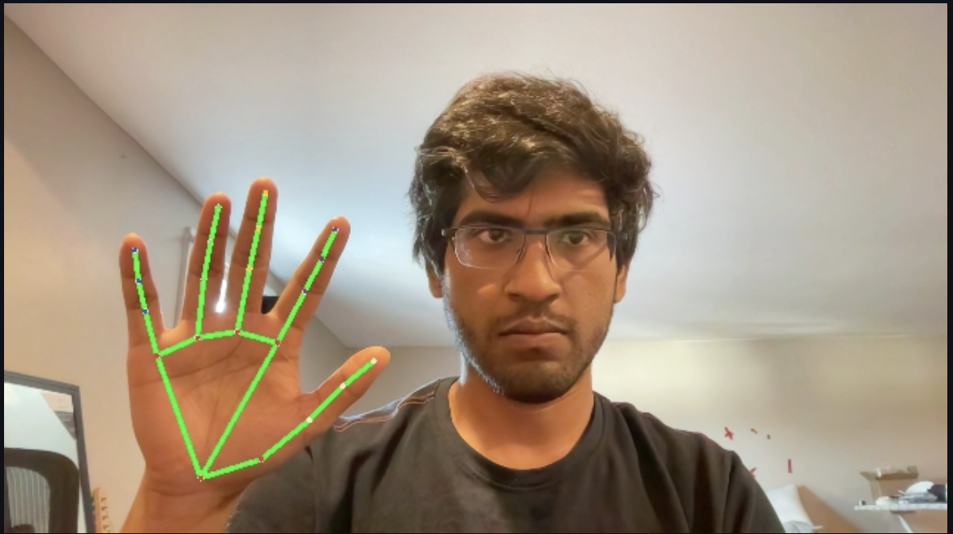
Data Set Collection
XY coordinates: (Letter)
Raw Image
Hand Landmarks
x: 0.27769408
y: 0.8786072
, x: 0.3502475
y: 0.8326882
,
x: 0.27769408
y: 0.8786072
.
.
MediPipe HandLandmark Model

Slide 10
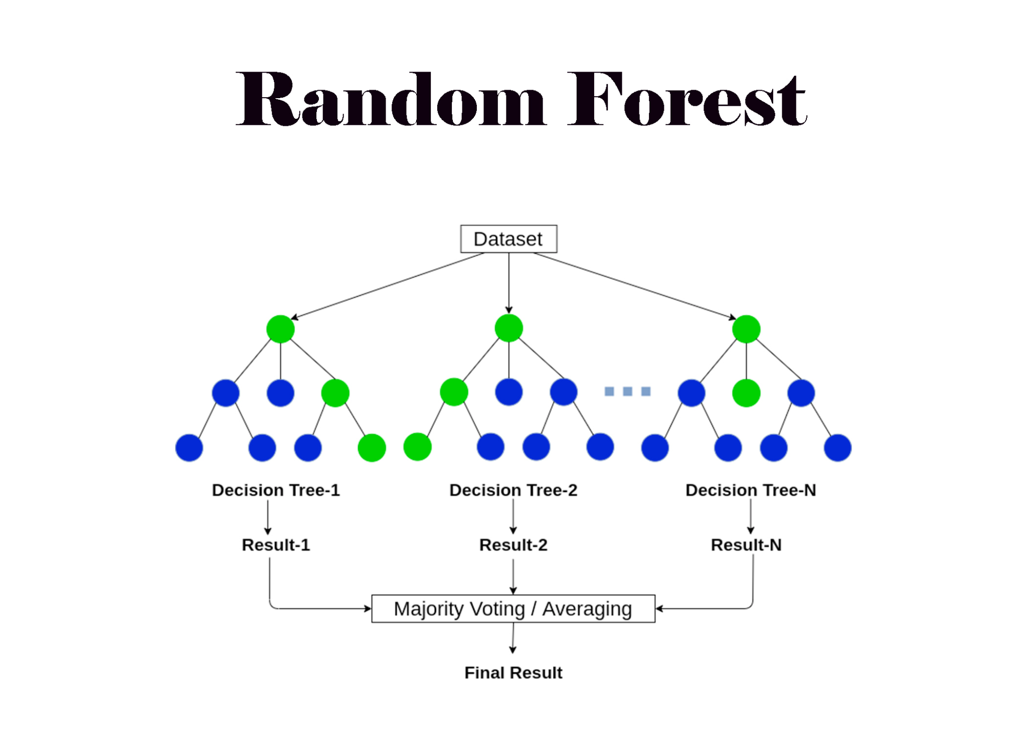
Sign Language Detector Model
Choice of Model - Random Forest:
Selected for its robustness and effectiveness in complex classification tasks.
Operates by constructing multiple decision trees and using a voting mechanism to determine the most common output class.
Computational Efficiency:
Requires minimal computational resources, making it suitable for environments with limited processing power.
Suitability for Mobile Devices:
Optimized for performance on mobile devices, ensuring effective real-time applications without draining device resources.

Slide 11
ML Pipeline
MediPipe HandLandmark Model
Random Forest Classifier
Predicted Letter

Slide 12
DEMO

Slide 13
Tools Used
OpenCV:
Utilized for managing image and video data.
Performs crucial operations such as frame extraction and pre-processing.
Google MediaPipe:
Employed for its advanced capabilities in Hand Landmark Detection.
Provides accurate and efficient processing of hand gestures.
Scikit-learn:
Used for training and deploying the Random Forest Classifier.
Chosen for its robust machine learning tools that simplify model development.
StreamLit:
Facilitates the rapid development of interactive web applications.
Allows for easy integration of machine learning models with web interfaces.

Slide 14
Future Work
Code Deployment on Mobile Devices:
Ensure the code is optimized for mobile platforms to facilitate seamless operation and accessibility.
Enhanced Letter Detection:
Implement advanced algorithms to detect similar ASL letters with improved accuracy, enhancing user experience and learning.
Training a Comprehensive Model:
Develop a machine learning model capable of recognizing entire ASL words, not just individual letters, for a more complete understanding.
Migrate UI to ReactJs:
Streamlit is not suitable for interactive applications which needs to react to user inputs.
Interactive Learning Interface:
Design a game-like interface that makes learning ASL engaging and interactive, helping users to learn through play.

Slide 15
Contribution
Rahul - ML Inference Pipeline:
Responsible for the ML inference pipeline, incorporating the HandLandmark model and Random Forest for real-time gesture recognition. Also contributed with the UI.
Partesh - Training Data Pipeline:
Developed the training data pipeline to generate and preprocess data necessary for training the models efficiently. Also performed evaluation of the model.
Baibhav - UI Design and Integration:
Leaded the design of the user interface, focusing on user-friendliness, while also handling the technical integration with backend services for seamless functionality.

Slide 16
Questions

Slide 17
Thank You

